Slide 1
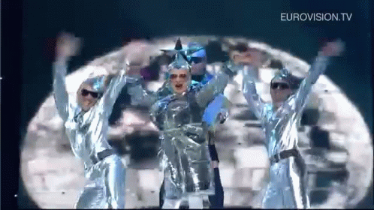
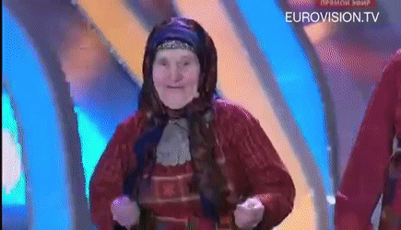

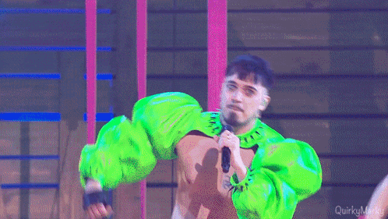


Slide 2
A geopolitical Analysis of the
Eurovision Song Contest Votes
Christopher Vogel - Data Analytics

Slide 3
Introduction to the ESC
How does voting work?
Why do I care?
Each country awards 1-8, 10, and 12 points
One set as jury vote
One set as televote
Max. 24 points for one country
Big discrepancies between my own perception and jury votes

Slide 4

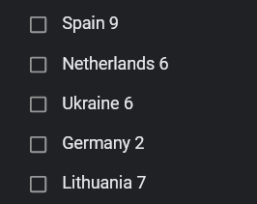
Ukraine 2022

Slide 5
How?
More on that later.

Slide 6
Who gives points who?

Slide 7
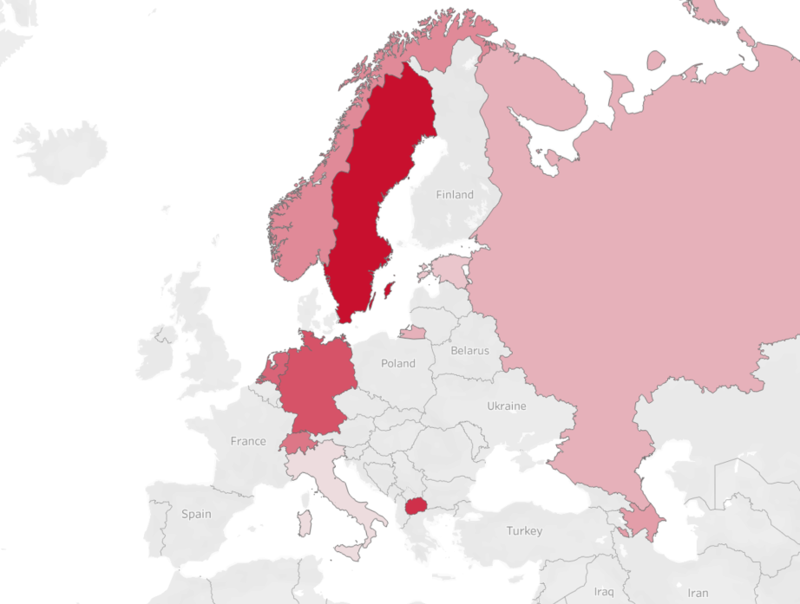
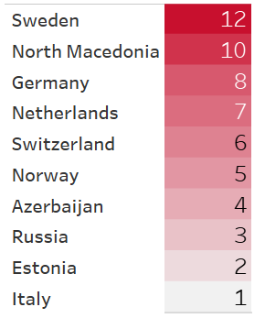
Denmark Jury Votes (2019)

Slide 8
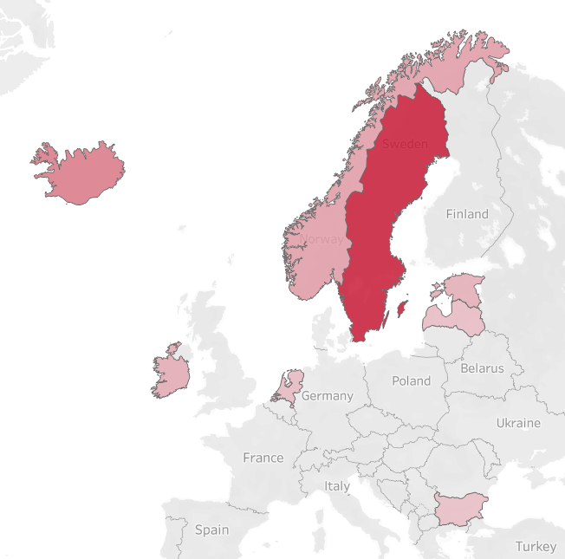
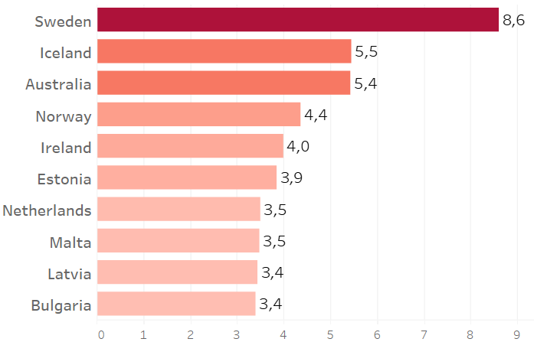
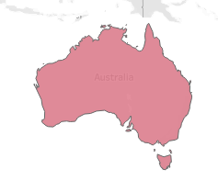
Denmark average Votes (1990-2023)

Slide 9
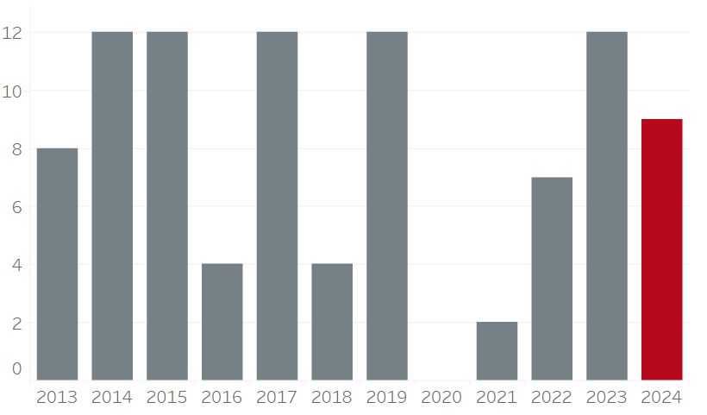
Denmark - Sweden Voting Prediction

Slide 10
Who gets points from who?

Slide 11
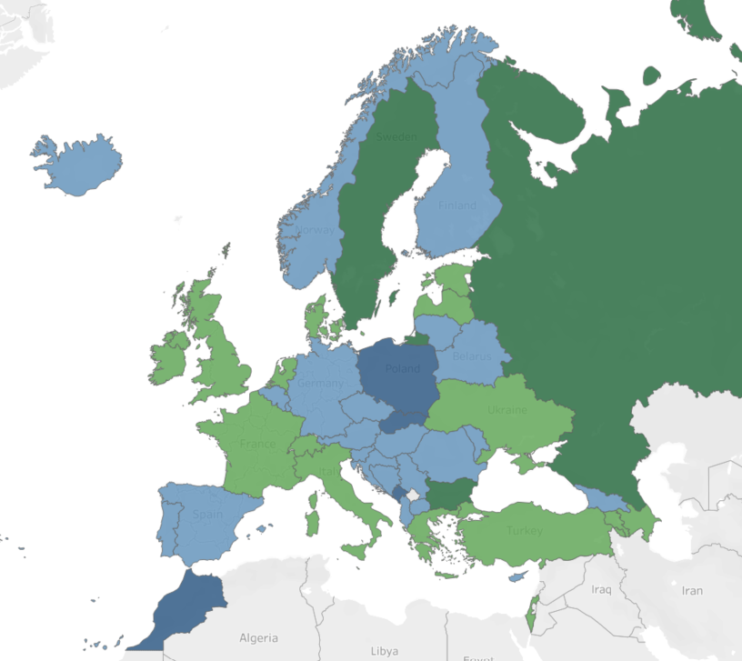
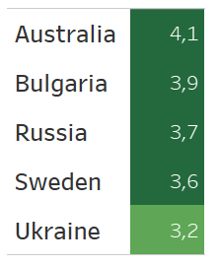
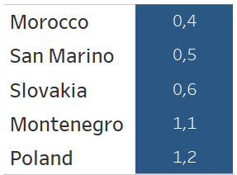
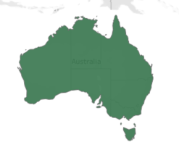
Average Jury Points received (1957-2023)

Slide 12
Potential Reasons
Political
Other
Political ties
Similar cultures
Geographic proximity
Statistical
“The Big Five”

Slide 13
Do Events affect Voting?

Slide 14
Correlation does not equal Causation!

Slide 15
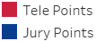
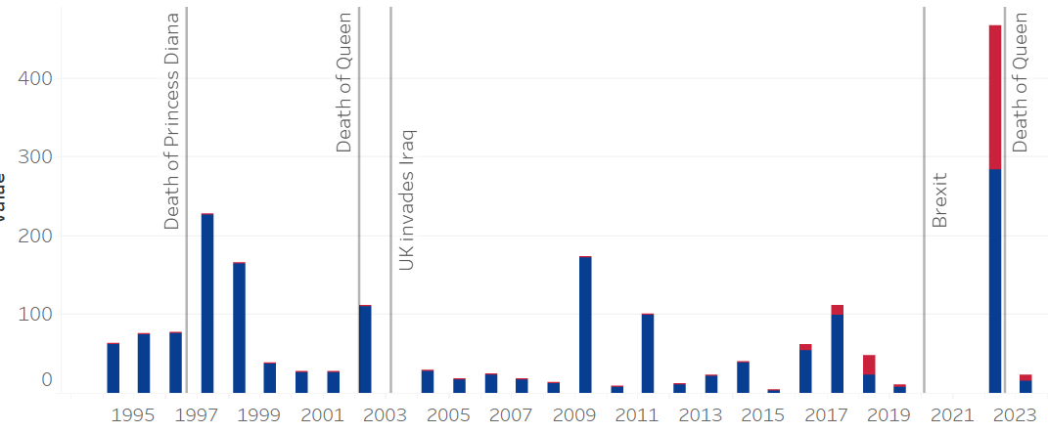
Timeline - United Kingdom

Slide 16
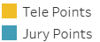
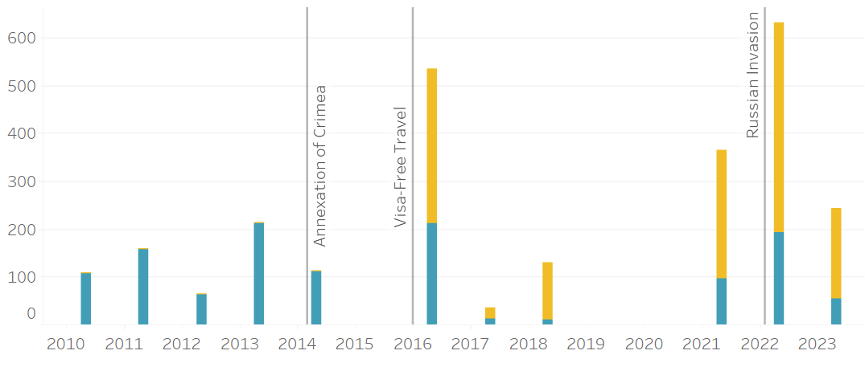
Timeline - Ukraine

Slide 17
Conclusions

Slide 18
Final Score
Chris vs Bootcamp
1 - 0
Pesto Pandas Data

Slide 19
Thank You!
Pesto Pandas Data
Data Sources
https://eurovisionworld.com/eurovision/2022
https://zenodo.org/badge/latestdoi/214236225
https://eurovision.tv/about/facts-and-figures
Tech Stack
Python, Pandas, Tableau

